Slide 1
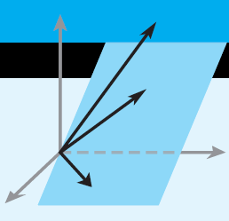
Elementary Linear Algebra
Howard Anton
Copyright © 2010 by John Wiley & Sons, Inc.
All rights reserved.
Chapter 7

Slide 2
Chapter 7
Diagonalization & Quadratic Forms
7.1 Orthogonal Matrices
7.2 Orthogonal Diagonalization
7.3 Quadratic Forms
7.4 Optimization Using Quadratic Forms
7.5 Hermitian, Unitary, and Normal
Matrices

Slide 3
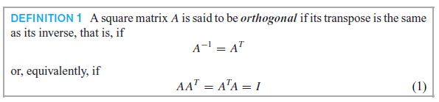
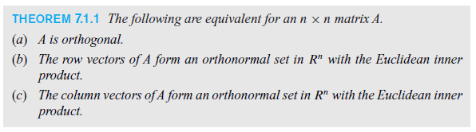
Section 7.1 Orthogonal Matrices

Slide 4
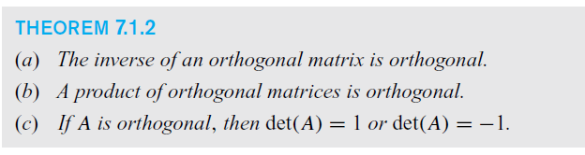
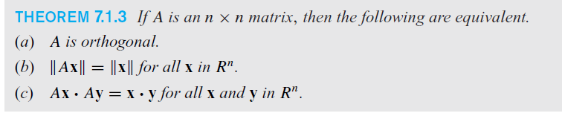

Slide 5
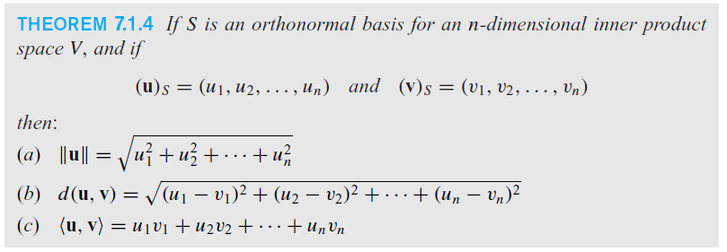
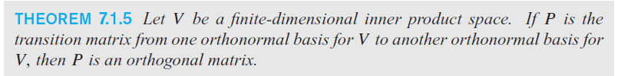
Orthonormal Basis

Slide 6
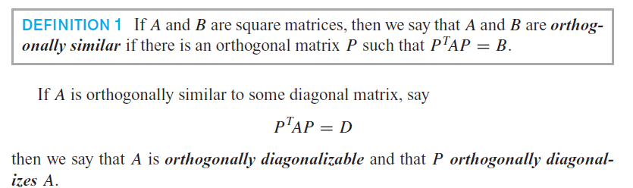
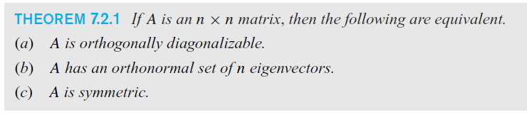
Orthogonal Diagonalization

Slide 7
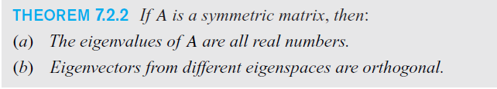
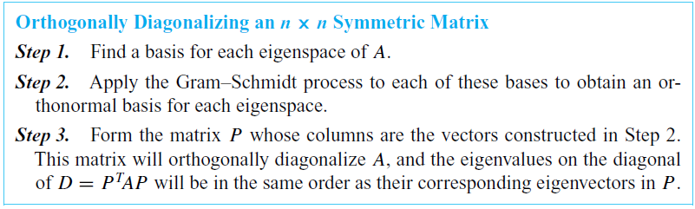
Symmetric Matrices

Slide 8
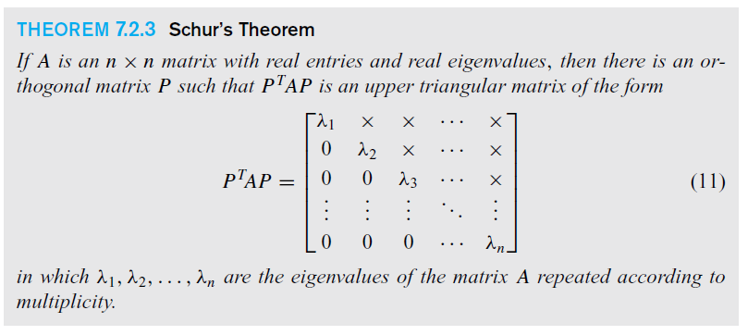
Schur’s Theorem

Slide 9
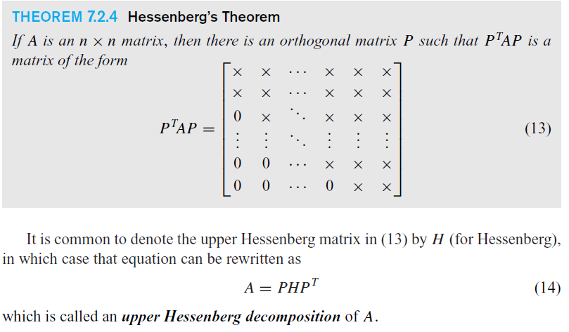
Hessenberg’s Theorem

Slide 10
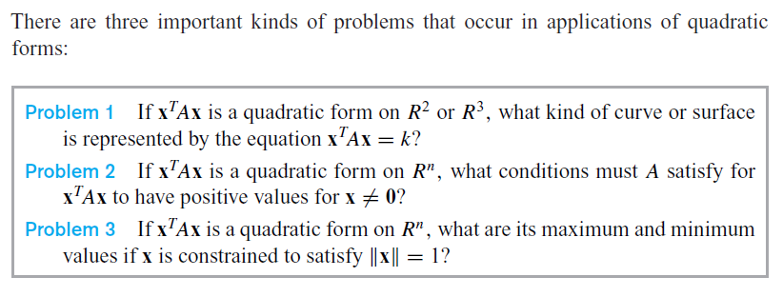
Section 7.3 Quadratic Forms

Slide 11
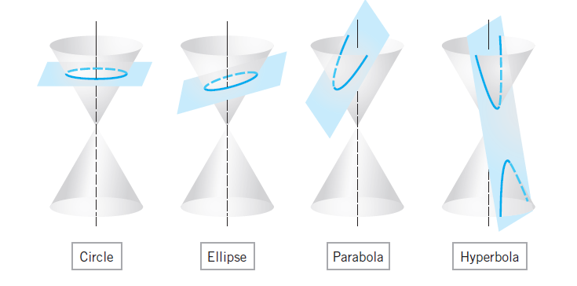
Conic Sections

Slide 12
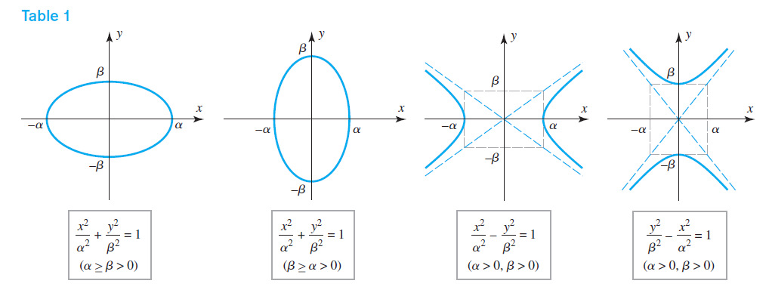
Central conics in standard position

Slide 13
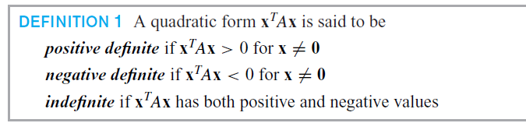
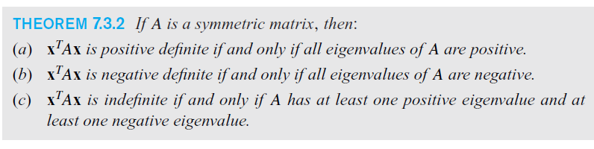
Definite quadratic forms

Slide 14
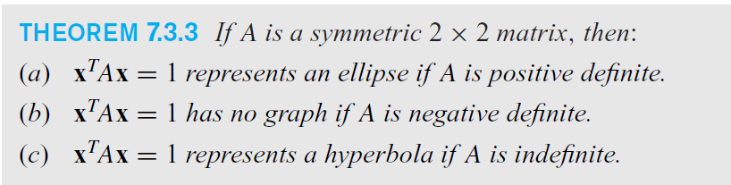
Ellipse? Hyperbola? Neither?

Slide 15
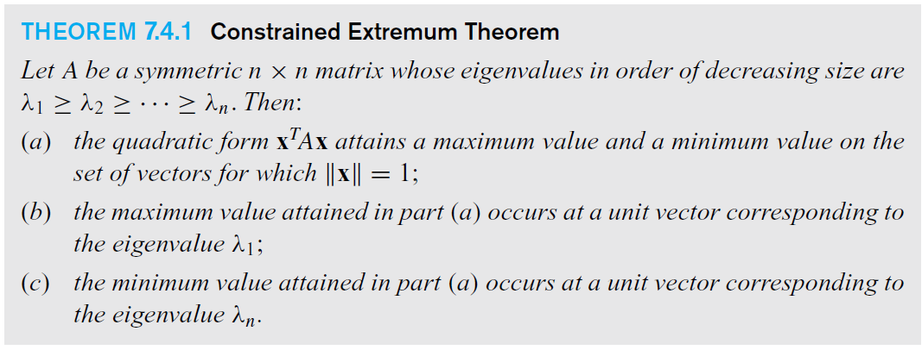
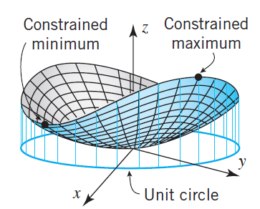
Section 7.4 Optimization
Using Quadratic Forms

Slide 16
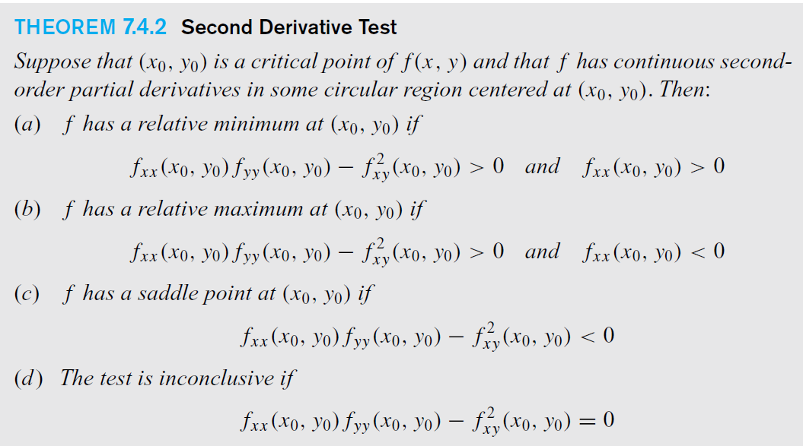
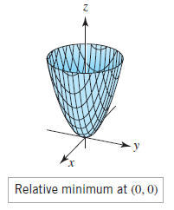
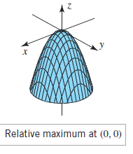
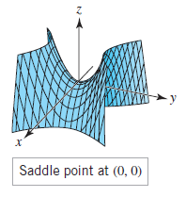

Slide 17
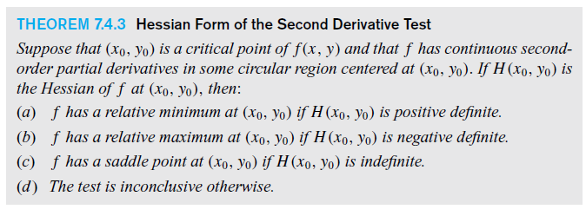
Hessian Form of the second derivative test

Slide 18
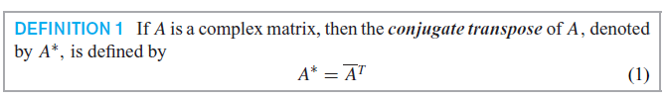
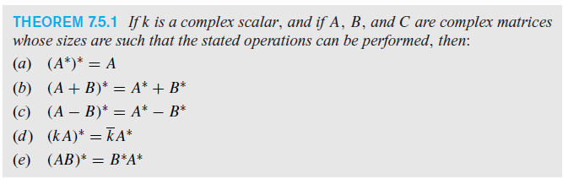
Section 7.5 Hermitian, Unitary and Normal Matrices

Slide 19
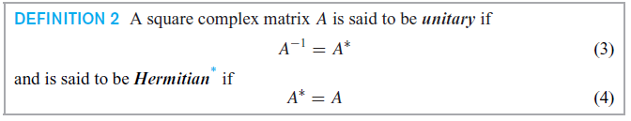

Hermitian Matrices

Slide 20
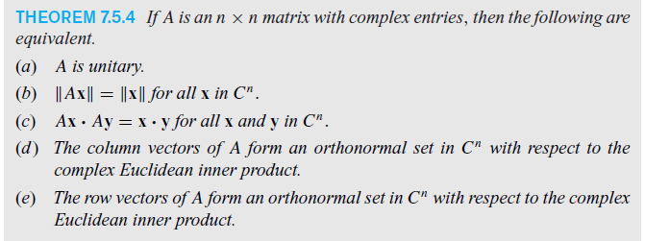

Unitary Matrices

Slide 21

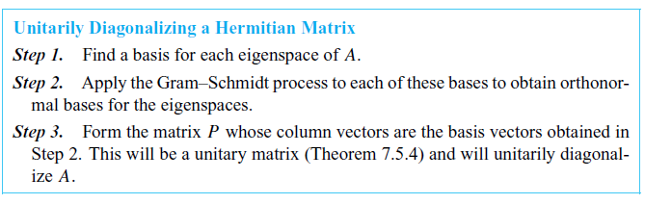
Unitarily Diagonalizing a Hermitian Matrix

